Slide 1
CoLab.online Reducing the Stress of Collaborative Work for You and Your Teams
Micah Gideon Modell
https://CoLab.online
http://PeerAssess.info
Notes:
My name is Micah Modell and I’m a computer programmer and a professor, so I know that learning in teams can be awesome, but often isn’t. I’m here to tell you CoLab.online’s quick and easy weekly check-ins can help instructors support their teams so we get the most out of them.

Slide 2
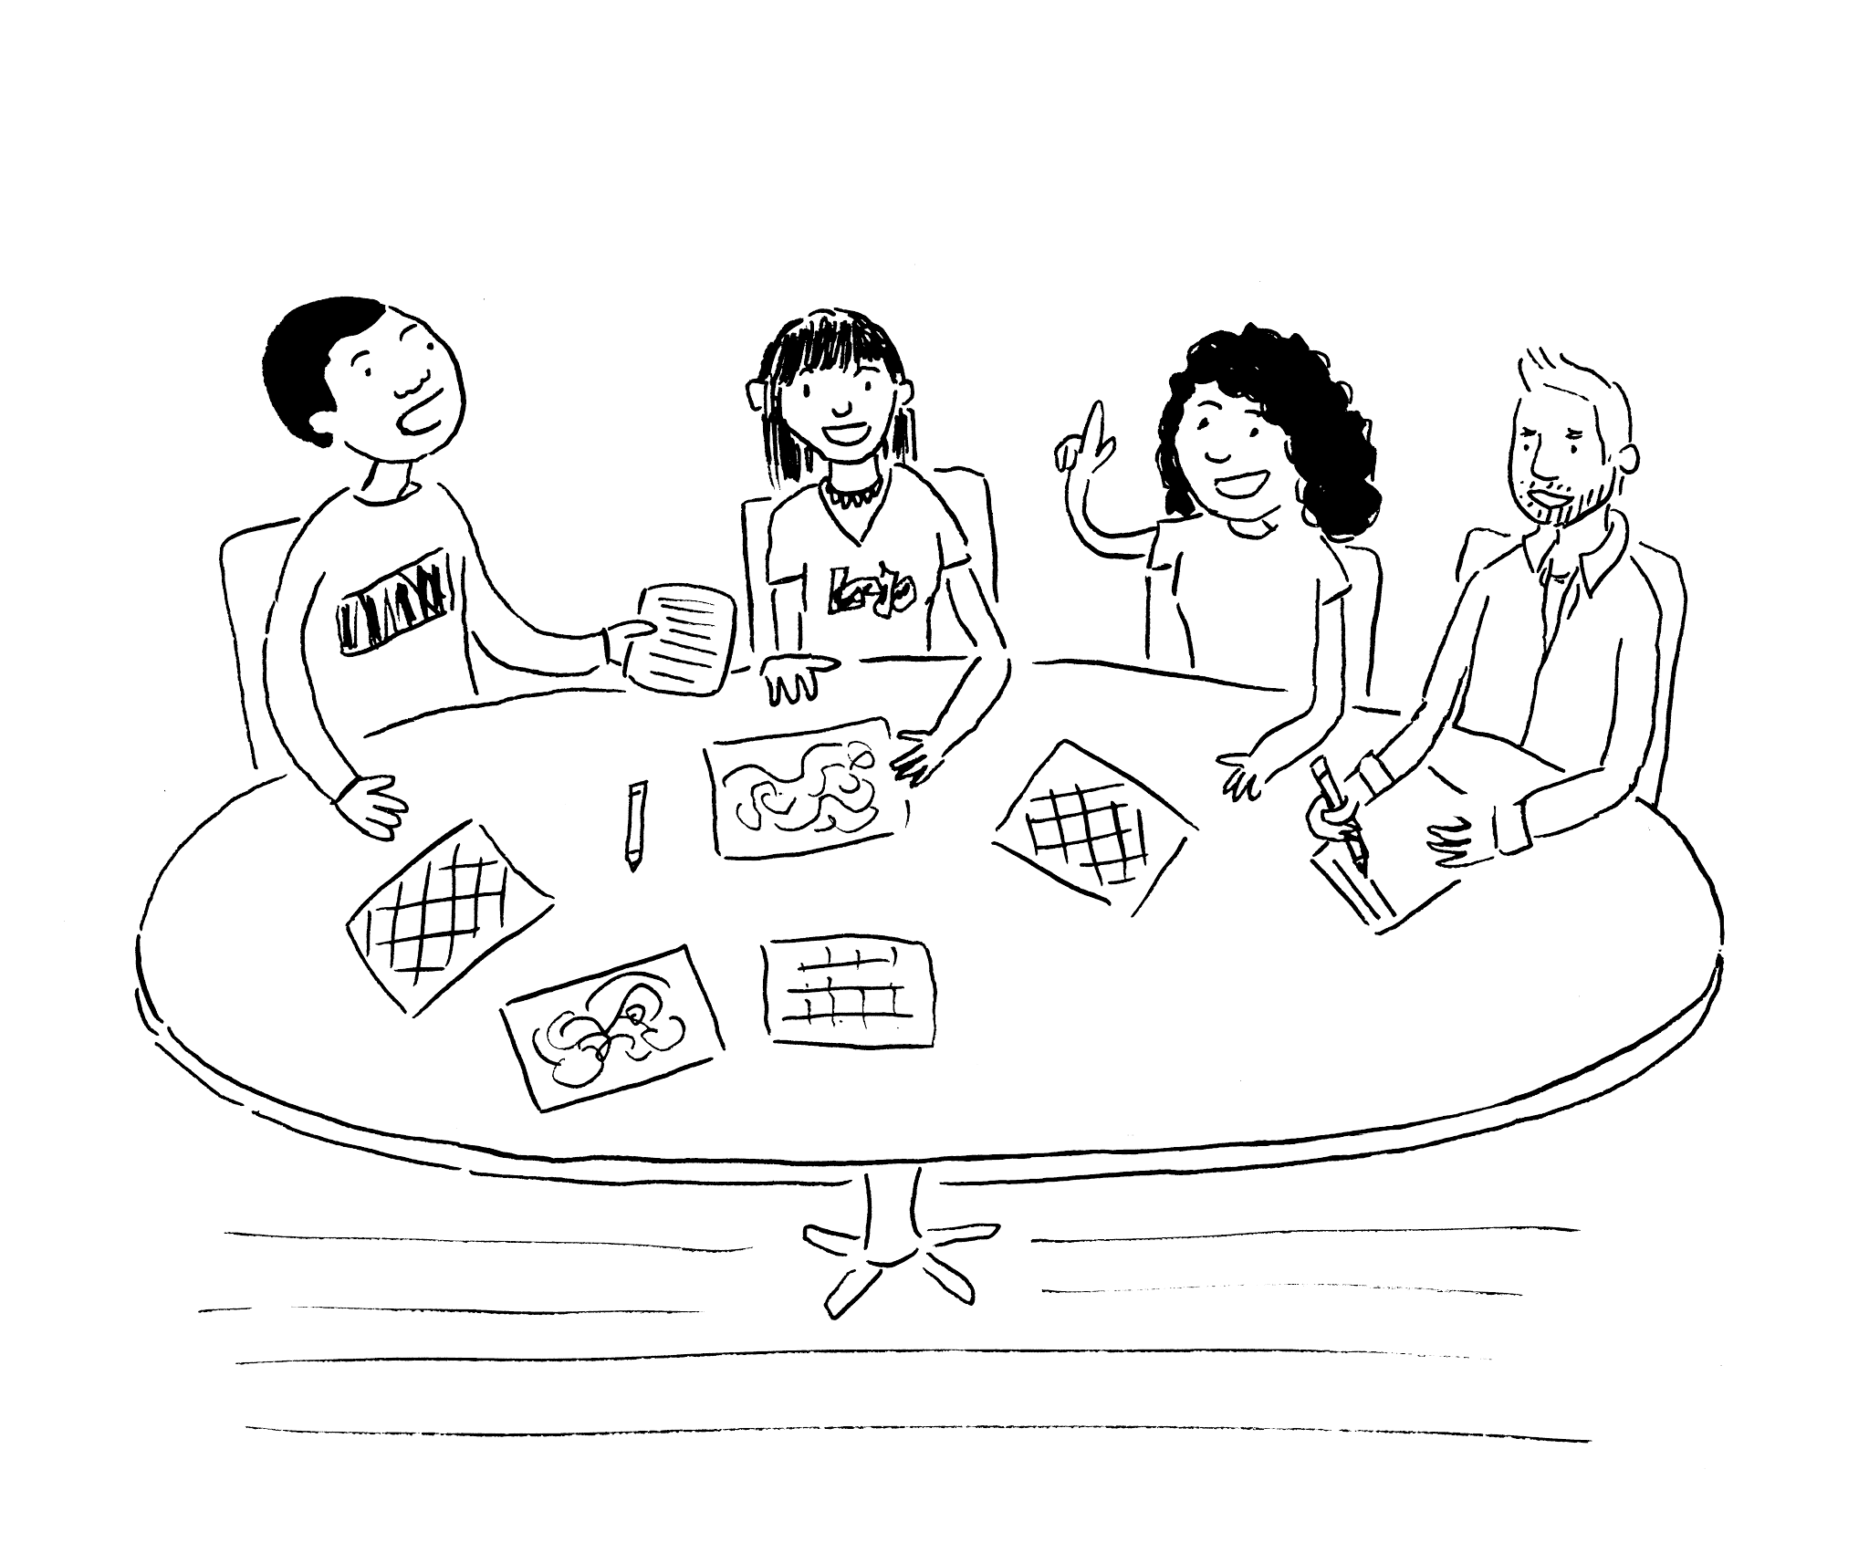
Does your dream of teamwork…
Manpower
Skills
Perspective
Notes:
Our dream of teamwork is students learning from each other, seeing things in a new way and tackling ambitious projects because they have enough people to get them done.
Unfortunately, that doesn’t always happen.
Maybe this is familiar? It’s the end of the semester

Slide 3
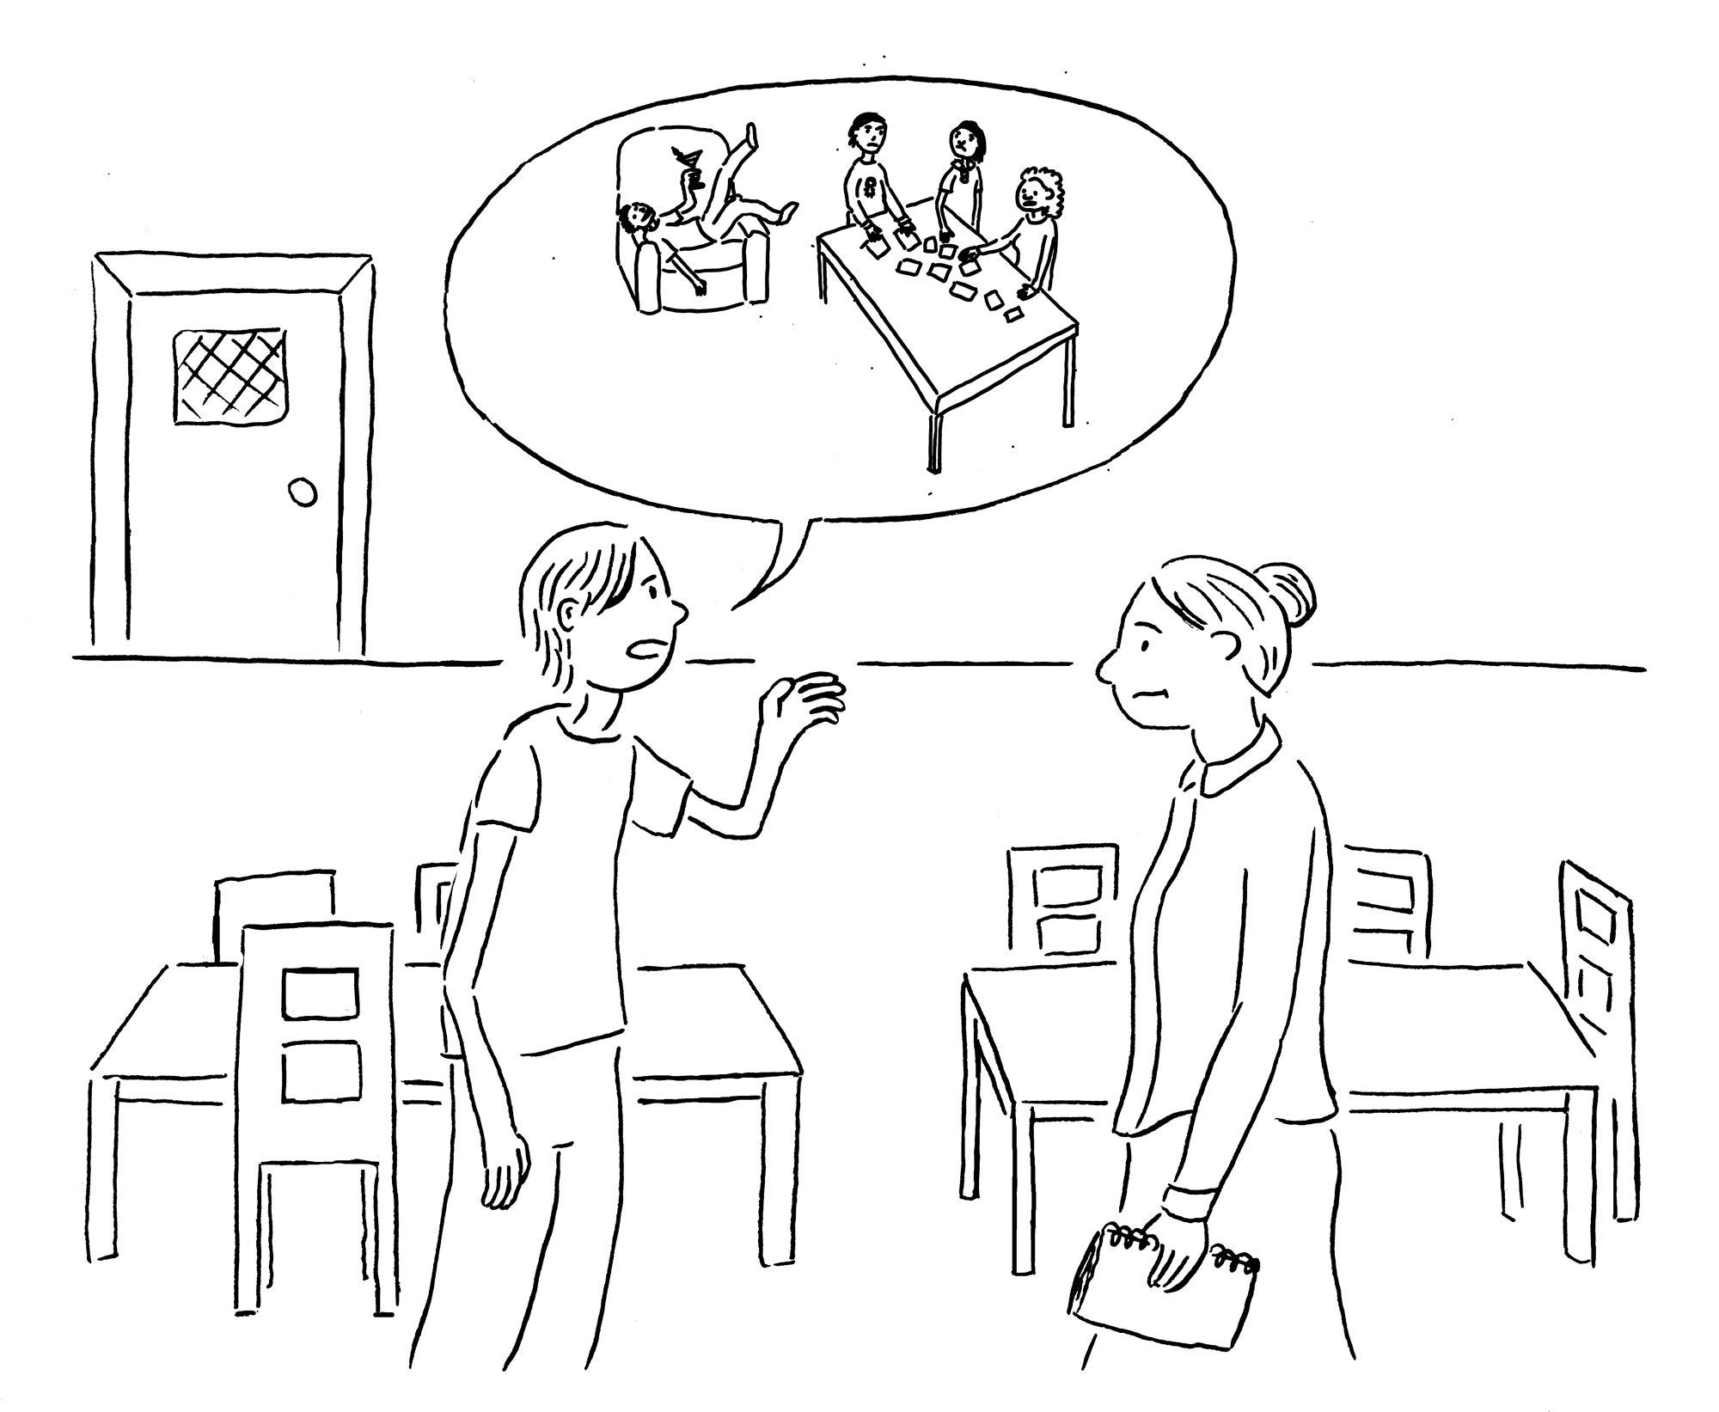
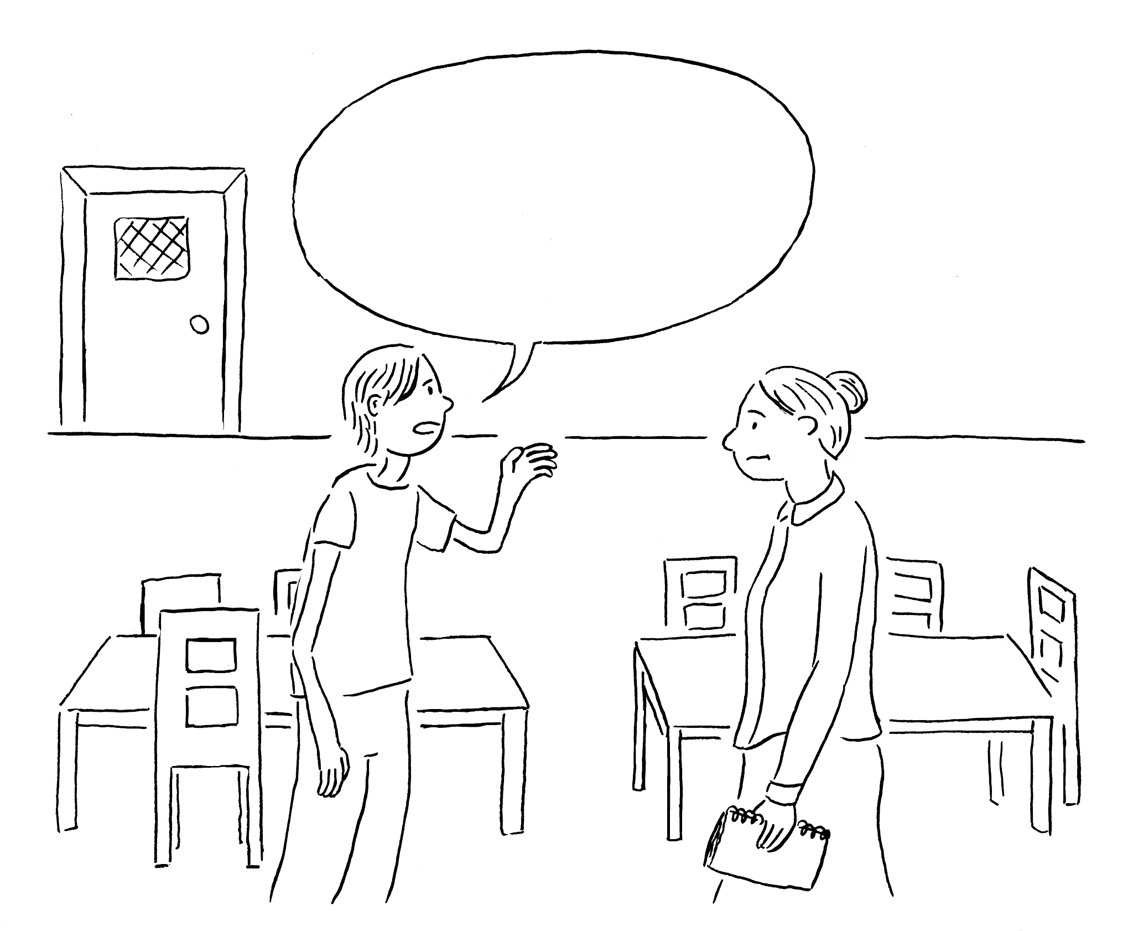
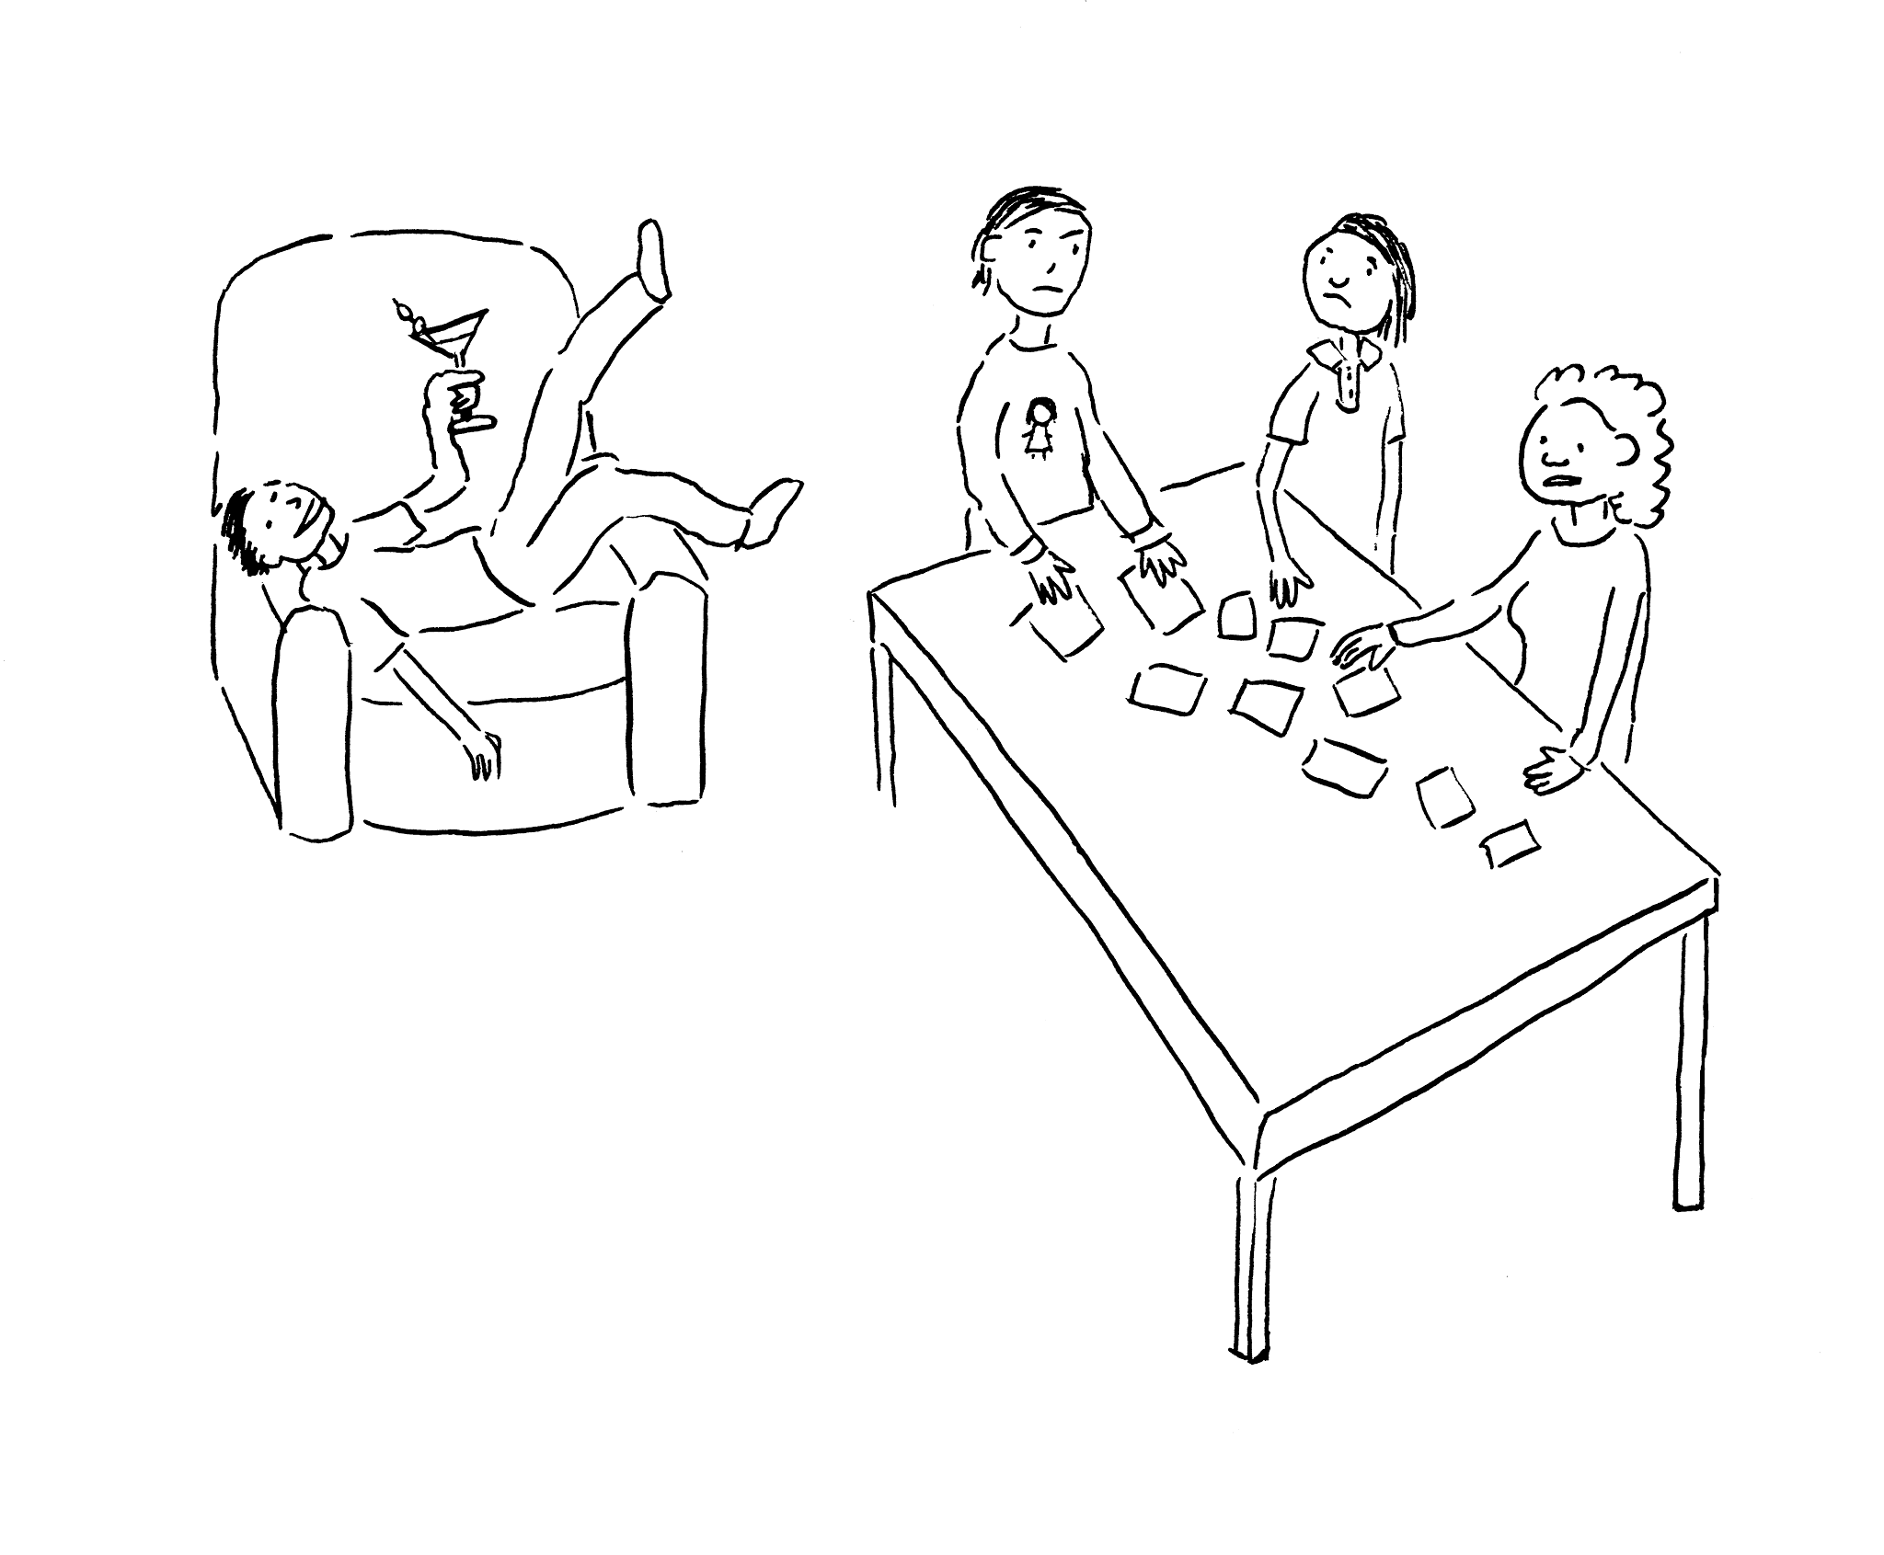
Often turn into this?
Notes:
and a team member reports that while he and some colleagues have been working hard, one of their team member hasn’t been carrying their fair share of the load.
Regardless of the circumstance, this is no fun for anyone – and the instructor's hands are tied. Who to believe? What sort of consequences could make sense and actually help?

Slide 4
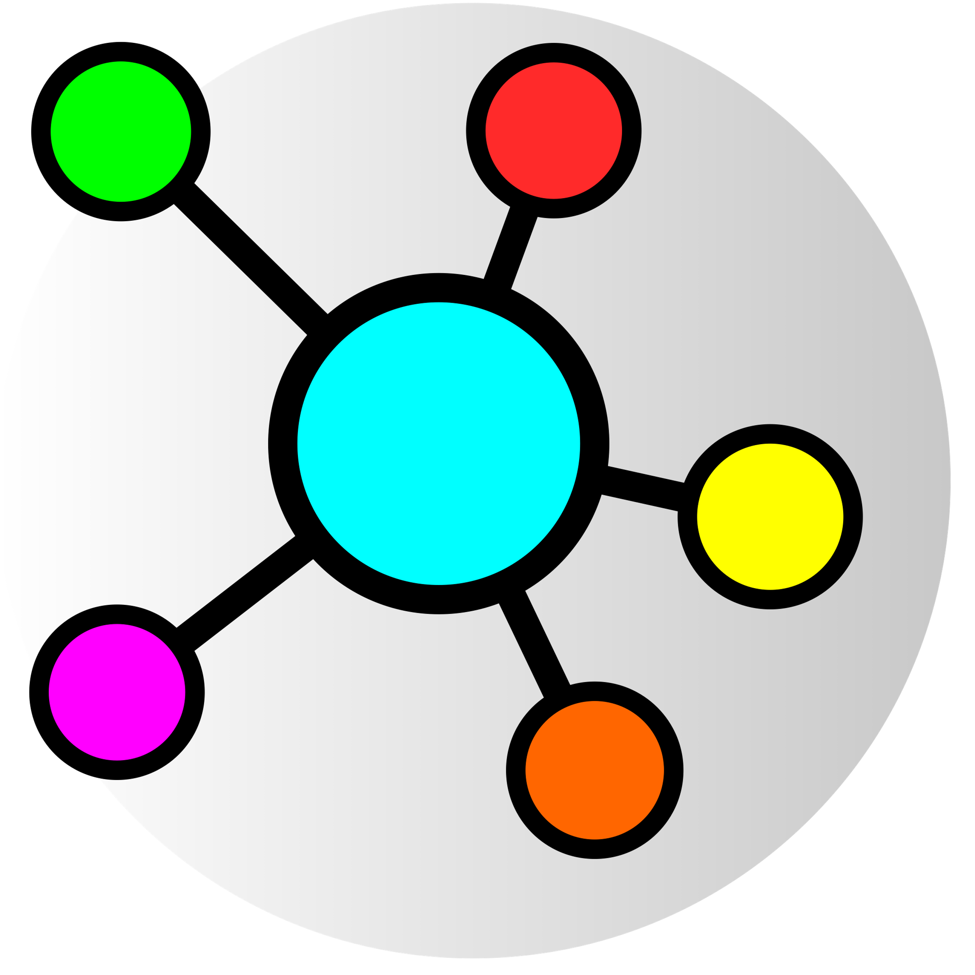
CoLab.online can help!
Self- and peer-assessment
Focused on groups (not individuals)
Weekly data collection
Visualizations
And more!
Notes:
Enter CoLab.online.
CoLab-supported teams check-in weekly on how the team is operating and then CoLab shows instructors which ones are having problems – let’s have a look.

Slide 5






Competition
Growth-oriented
CoLab.online
Corporate
Academic
Judgment-oriented
Notes:
There are other products out there that might look similar, but CoLab is the only one for higher ed that’s focused on nurturing skills rather than judging students.

Slide 6
Competitive Competitive Advantages
Focused on team rather than the individual.
Interface designed for speed of completion.
Data tells a story.
Visualizes data as story for instructors.
Notes:
While others ask students to rate each other, CoLab asks how teams are contributing – regularly, quickly and easily. Then, we make it easy for instructors to make sense of the information so they can get in there and support those teams.

Slide 7
CoLab.online
Build students into valuable team citizens.
Notes:
So, if you’re taking a class that relies upon teamwork, ask for CoLab to make sure you’re set up for success. And instructors, when they ask for it, you should listen!

